Slide 1

DIGI Menu
A better food Ordering experience

Slide 2
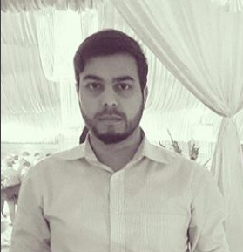
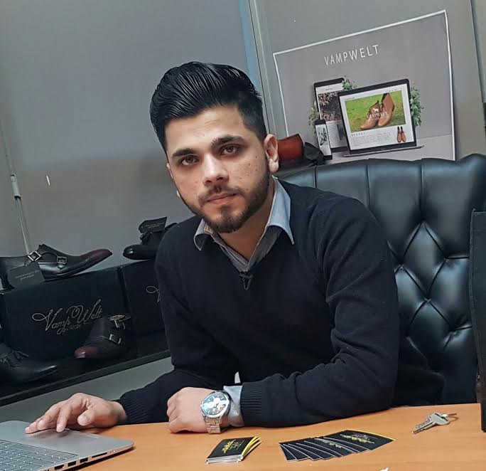

Team Members
M Ali Ahmed
Bscs13016
Ahmad nawaz
Bscs13046
Moazzam shoukat
Bscs13016

Slide 3
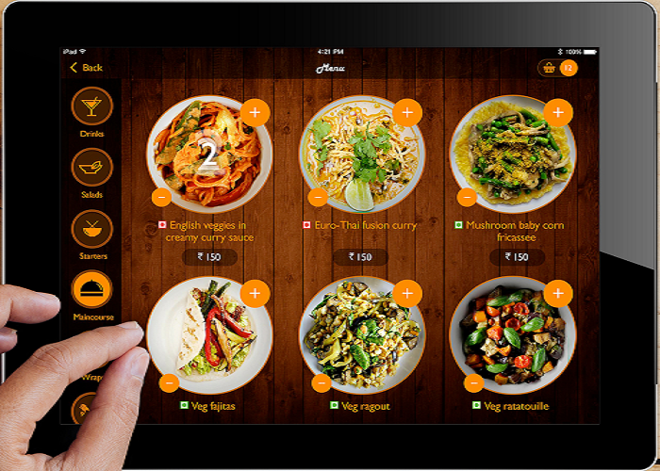
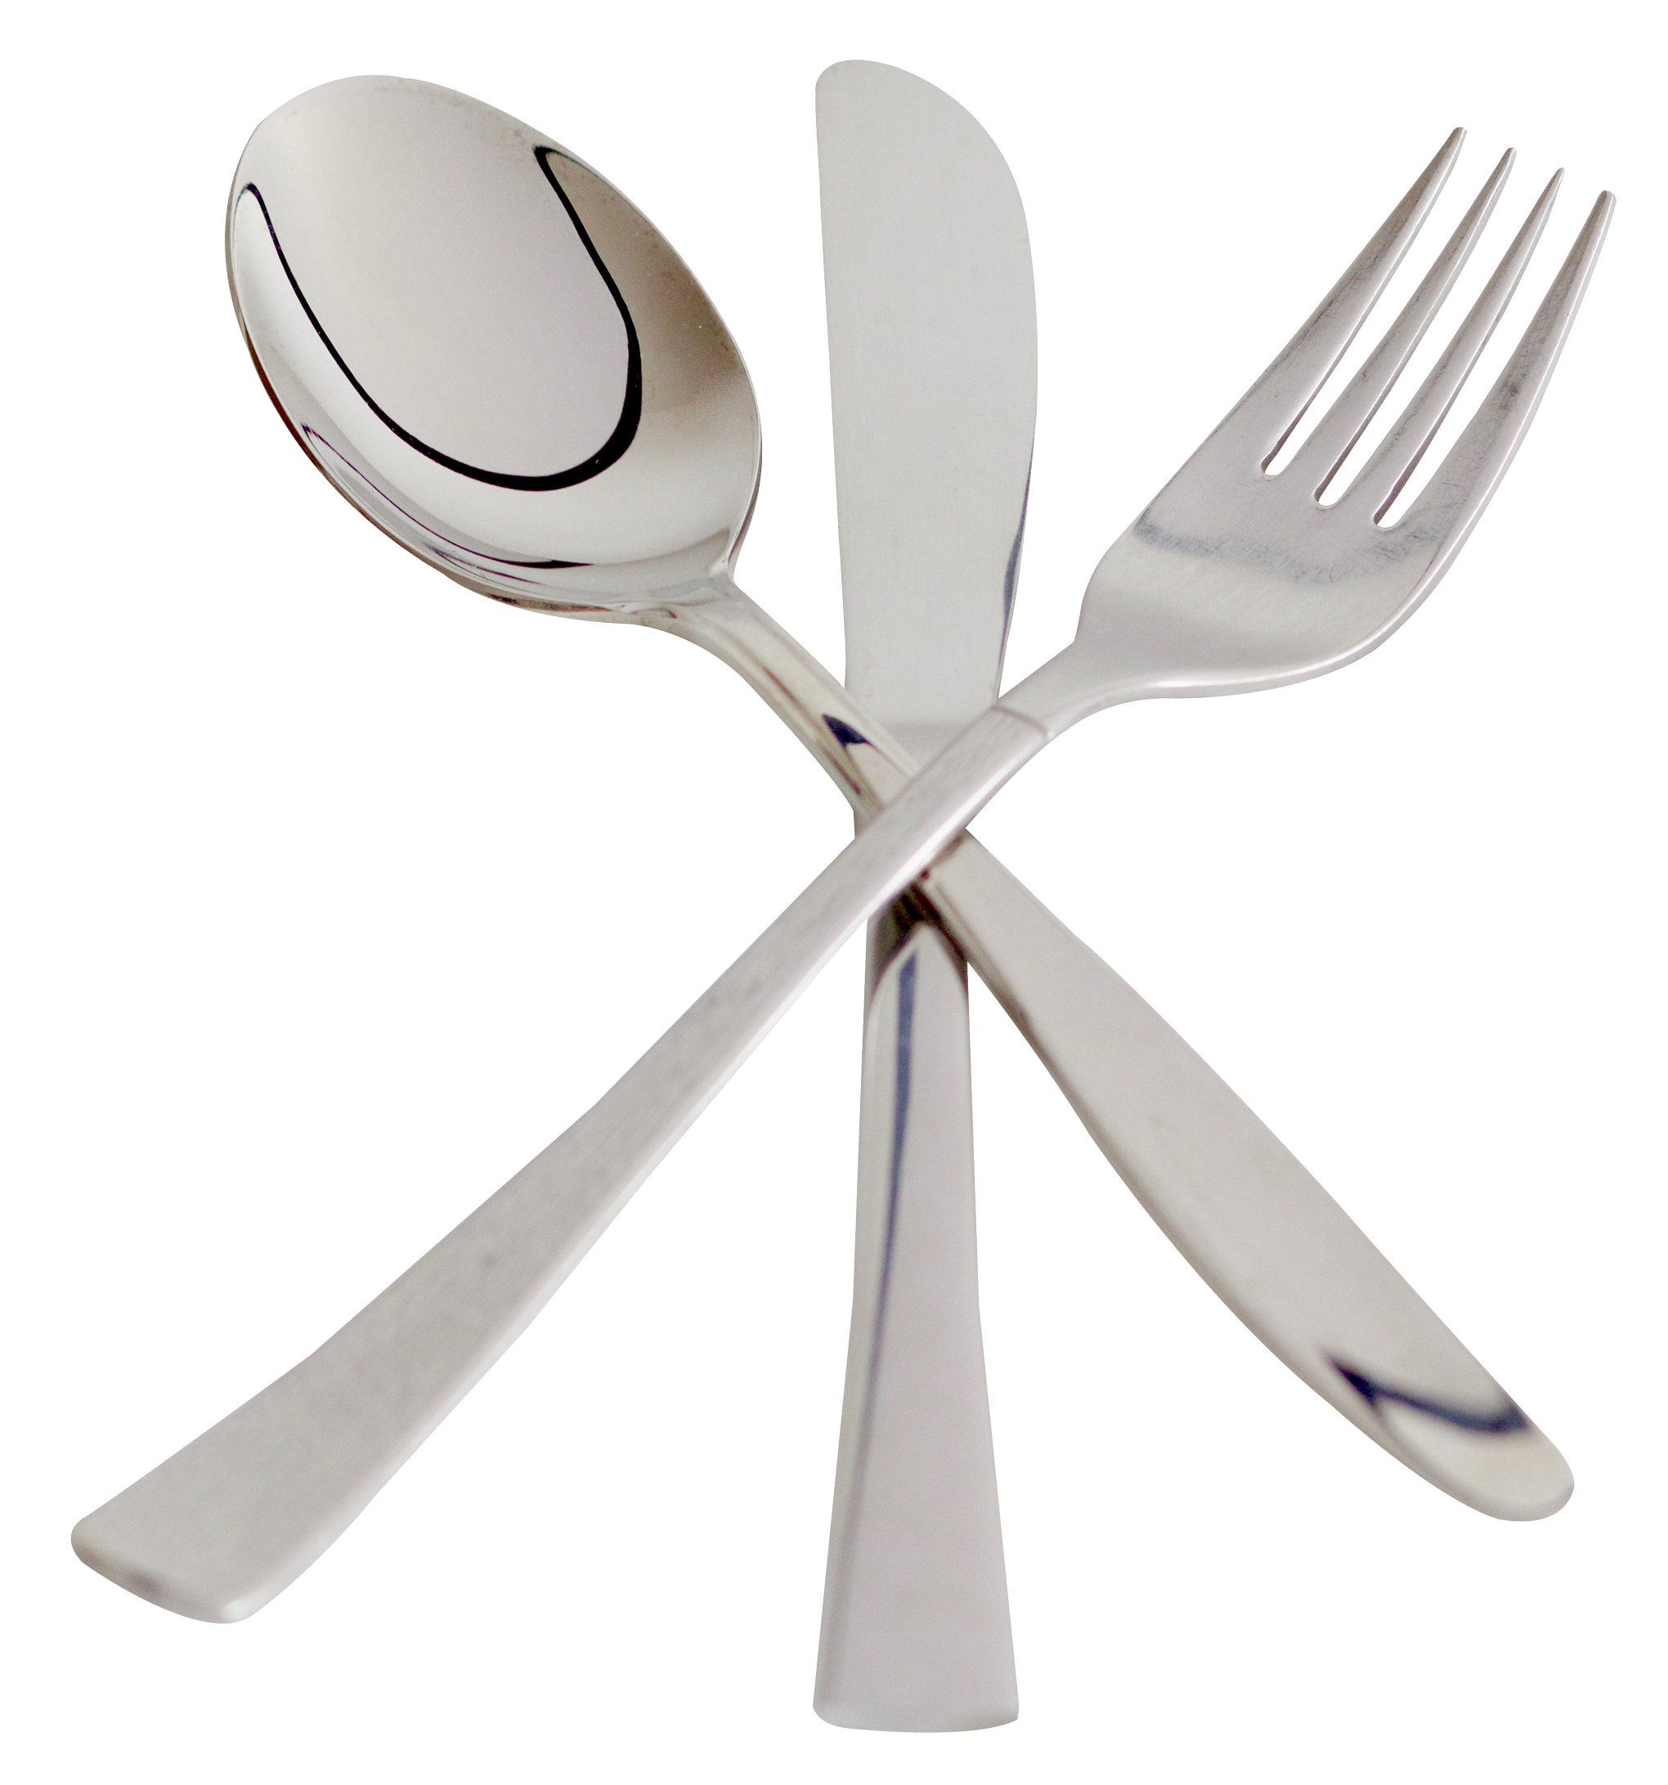
Problem Domain
A better visual food ordering app
Restaurant Digital Menus app improves Customer Satisfaction
Digital Restaurant Menu Food Ordering App provides Time Saving for Consumers as well as Restaurants

Slide 4
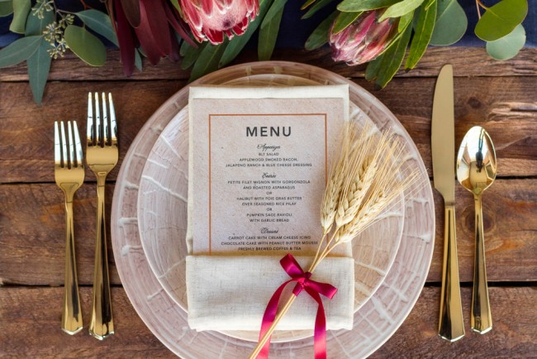
Problem Domain
Currently the food apps and paper menu which exists are quite limited.
There is no way to show a new introduction of deal.
They have to reprint the whole paper menu and distribute.
Usually it does not make sense what is on the menu people cannot visualize the food ordered that will appear in front of them.

Slide 5
Interviewee
Person who dine at a restaurant and eat
Person who order food online
Person who manages the menu at restaurant
Advertising department of restaurant
Owner of restaurant

Slide 6
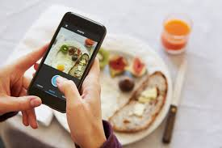
Needfinding and its results
A good visual app is required to make the food ordering system a good experience.
Making it easy and visually better.
Allowing the customers to share their photo reviews.
Special deals and promotions.

Slide 7
POV (1) :We met Ayesha who was very much interested in knowing the how the dish will appear and taste before ordering and it will be gae changing for other people who thinks of this problem

Slide 8
How Might We?
HMW built something to show the pictures of food items
HMW show actuall pictures
HMW take pictures
HMW bring customers and restaurant on board
HMW take orders
HMW use tech to help us
HMW build a better UI and UX
HMW market it
HMW use AI to recommend food
HMW implement picture reviews

Slide 9
3 Best HMW
HMW built something to show the pictures of food items
HMW show actuall pictures
HMW take orders

Slide 10
POV (2):We met the owner who showed interest in this unique idea of attracting and reaching customers he said it would be game changing if they get this type of service

Slide 11
How Might We?
HMW we make website
HMW make app page
HMW get customers
HMW built a backend
HMW appearance on social media
HMW give speical deals
HMW give discounts and rewards to users
HMW to market the restaurant page

Slide 12


3 Best HMW
HMW make app page for restauraunts
HMW get customers
HMW implement ratings system

Slide 13
Solution
We will built an app that will offer deals and display a digital menu
It can be accessed through a smartphone
You can also choose the item, add addon and upgrade meals from the app
You can also check the rating of dishes and restauraunts
You can order food online and at dine in

Slide 14
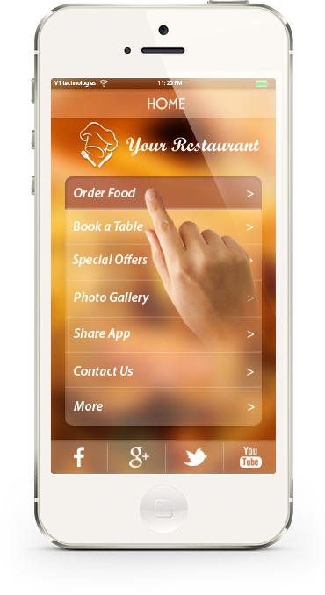
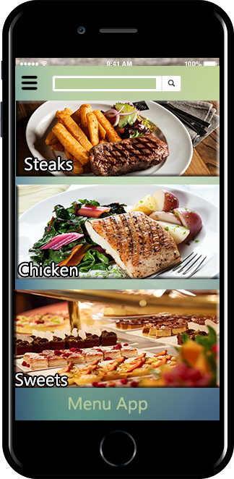
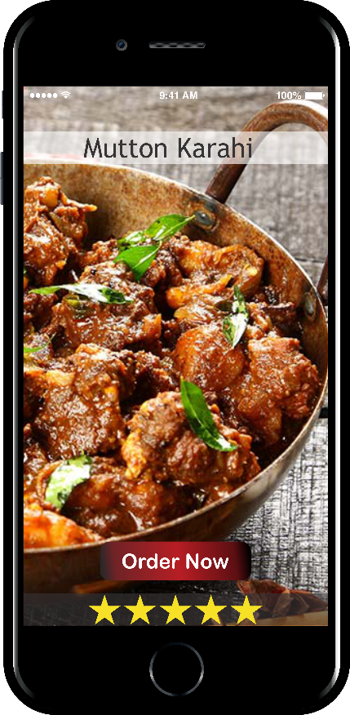
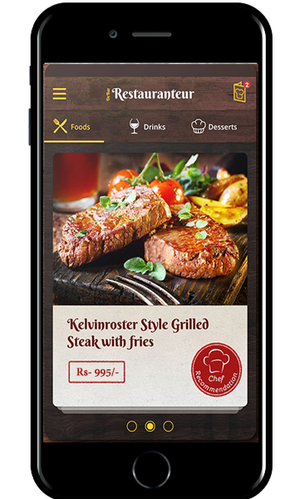
Prototype

Slide 15
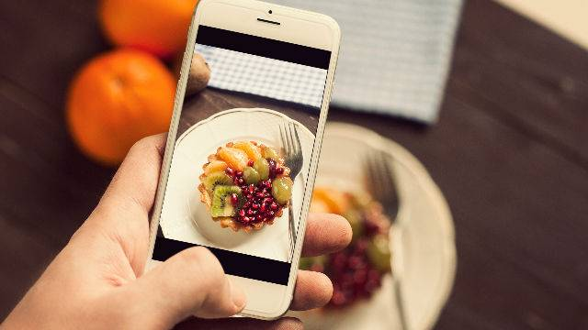
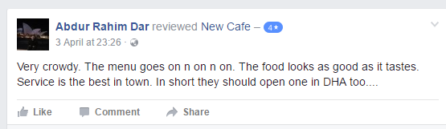
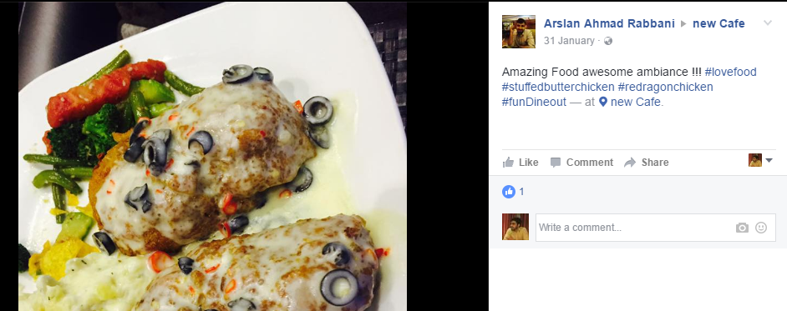
Photo & Text reviews

Slide 16
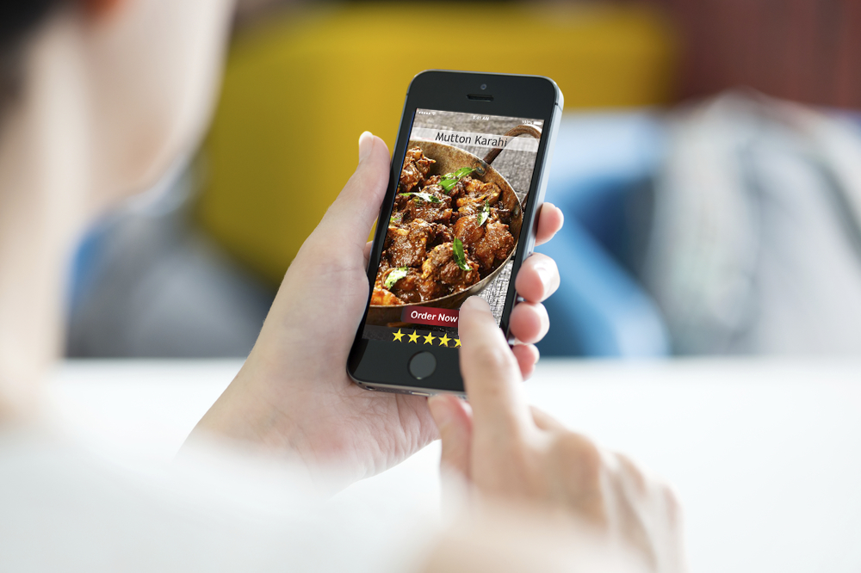
How it was be tested
Prototypes were images and were shown to only friends yet.
They tested the app, looked at the images
They gave feedback

Slide 17
Things that worked
It was easy to use
Simple plain app wit better UI
Unique idea

Slide 18
Things that didn’t worked
There was no table selection option which was raised
There was no table reservation system
we also tried to mention the ingredients but it was just an extra effort and didn’t worked

Slide 19
Surprises
Picture quality played a better role to see the food before ordering
App directly useable with no complexity

Slide 20
Validity of assumption
Our Assumption were more or less correct
New assumptions emereged like more pictures
Better photo reviews
Booking table and reserving it
Check for availability of seats
Any special deals and offers

